Slide 1
Ketto.org
Image building pr campaign

Slide 2
Situation analysis
Asia's most visited crowd funding platform
Starting a campaign is free
India’s largest crowd funding platform to raise funds for social, educational, charitable causes, technical, creative projects and entrepreneurial ventures in India
Offers supporters several modes to make contributions on Ketto - cash, cheque and online transactions
The founders’ vision for Ketto has been to make the idea of crowdfunding a cool, simple, reliable, safe and easy way of raising funds; to make it a one-stop solution for NGOs, individuals and corporates to garner support from backers across the globe

Slide 3
Situation analysis
Credible payment gateways
Elaborate authentication of NGOs they team up with - verification process is done, valid documents submitted
Similarly, for personal causes or individuals who are raising funds for personal needs , our team does basic verification and KYC of the individual before starting the campaign and approve only the genuine ones
Featured in – The Hindu-Business Line, Economic Times, DNA, TOI, Indian Express, NDTV, CNBC TV18, Economic Times, The Guardian
Runs a blog featuring the success stories

Slide 4
Research questions
Who is the campaign aimed at, and what are their characteristics? Masses equipped with the knowledge of internet – 18 to 45+ years of age. Empathetic, interested in reading/listening/knowing about others’ stories, supportive, with access to internet social media, financially stable.
Which are the best channels of communication to reach them? Social media, E-mails, guerilla PR, events/sponsoring events, blogs/vlogs, word of mouth.
What is the opinion of the TA about the company? Genuine, safe, innovative, user friendly.
Who are the influencers in this specific situation? Media, corporates, consumers – both donors as well as campaign owners.

Slide 5
Research methods
Informal: Personal contacts Online sources – blogs and social media discussions
Formal: Surveys through mailed questionnaires and in-person interviews Content Analysis

Slide 6
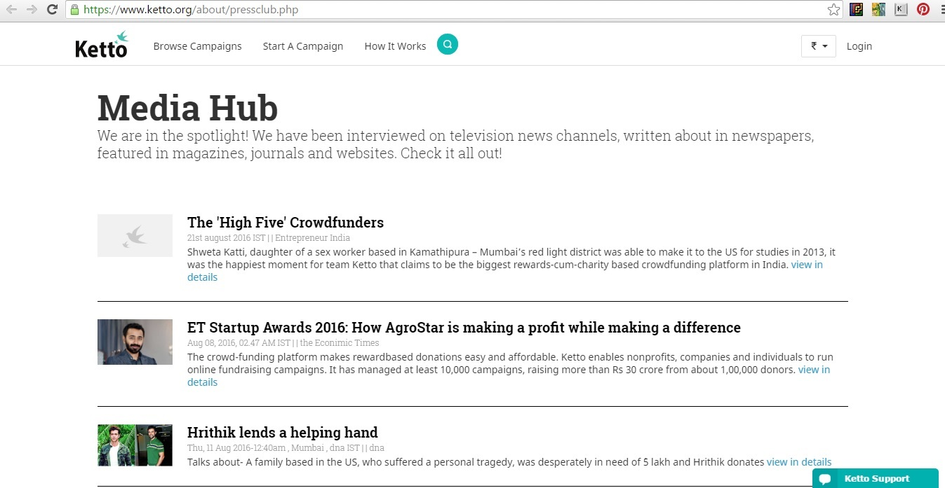
Communication Audit

Slide 7
Problem statement
A majority of target audience are unaware of the brand and it’s services; also, major chunk of users are ignorant about the same.

Slide 8
strategy
Goal:
To inform and reach out to maximum number of people about the brand
Target Audience:
18 to 45+ years old
Objectives:
To reach out to the TA through national PR
To boost awareness and generate interest in the brand
To tell the story of the business through people – human interest stories
To majorly use social media – both functionally and emotionally
To drive people to the website to sign up

Slide 9
strategy
Strategic Plan:
The PR campaign aims at providing people with the experience/feeling of happiness by being a crown funder.
Dispensing machines to be set-up at major public places like malls, airports, universities, corporate events etc.
A note and an increase in the happiness level to be achieved after putting in coins in the dispensing machines.
Campaign to be called Make a Happy Face.

Slide 10
Implementation/action
External tools to be used to carry out the planned strategy.
Press Release
Press Conference
Sponsoring with corporate events
WOM
Social media – hashtagging/vlogging

Slide 11
evaluation
The campaign generated 42 pieces of national print coverage including The Guardian, Times of India, The Hindu, Indian Express. There were 20 national broadcast stories including on CNN IBN, Times Now, Aaj Tak. 50+ online items. 65,000+ hashtag usage. 60,000+ views of the vlogs.
The campaign gained 80,000+ likes on facebook and 4,000+ shares of the videos. Number of tweets went up to 9,000+

Slide 12
Thank you ☺ questions?

